Slide 1
Practical techniques in understanding of CI/CD.
Spring-Boot Application. From Dev to Deploy.
External training <EPAM> DevOps KhAI_Summer 2019.
made by: Rakivnenko Dmytro

Slide 2
Used technologies:
Terraform – Infrastructure as a code;
Ansible – Configuration management;
AWS – Some Cloud provider;
Git – Version control;
Jenkins – Continuous integration;
Tomcat – Web-Server;
Code – Product code.
*- Provisioning, Configuration management, and Application-deployment

Slide 3

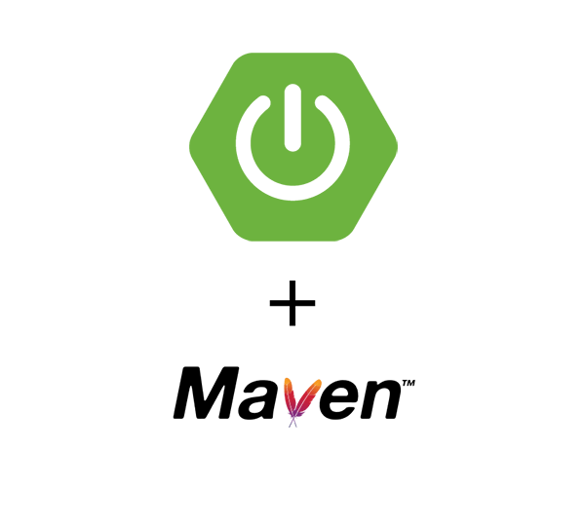

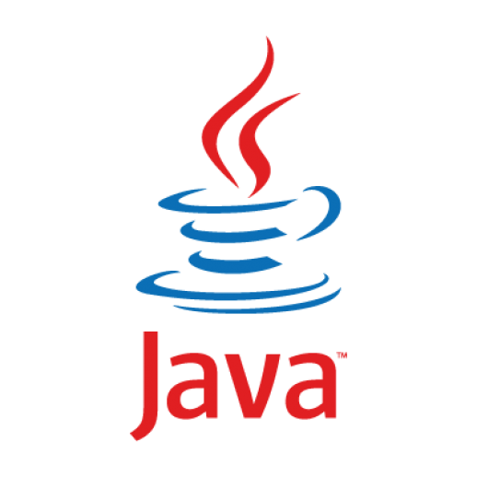



Infrastructure
Jenkins Master
HOST
Web-Server

Slide 4
resource "aws_instance" "Jenkins" { ami = "ami-00c03f7f7f2ec15c3"" instance_type = "t2.small" key_name = "newOhio" private_ip = "172.31.21.189" subnet_id = "subnet-be6433c4" vpc_security_group_ids = [aws_security_group.jenkinssg.id] root_block_device { volume_size = 20 volume_type = "gp2" delete_on_termination = true } tags = { Name = "Masters" } provisioner "local-exec" { command = <<EOT sleep 50; working_dir = "${var.ansible_dir}" ansible-playbook -i hosts.txt java.yml ansible-playbook -i hosts.txt maven.yml ansible-playbook -i hosts.txt Playbook-jenkins.yml EOT } }
Jenkins Master instance configuration.
resource "aws_security_group" "jenkinssg" { name = "Jenkins security group" description = "Security group for my needs for using Jenkins" vpc_id = "vpc-b4a051df" ingress { from_port = 8080 to_port = 8080 protocol = "tcp" cidr_blocks = ["0.0.0.0/0"] } egress { from_port = 0 to_port = 0 protocol = "-1" cidr_blocks = ["0.0.0.0/0"] } }

Slide 5









CI/CD Workflow
dev
commit
MASTER
Deployer
deploy
Buiding/testing
webhook
github
Jenkins Server
Server

Slide 6

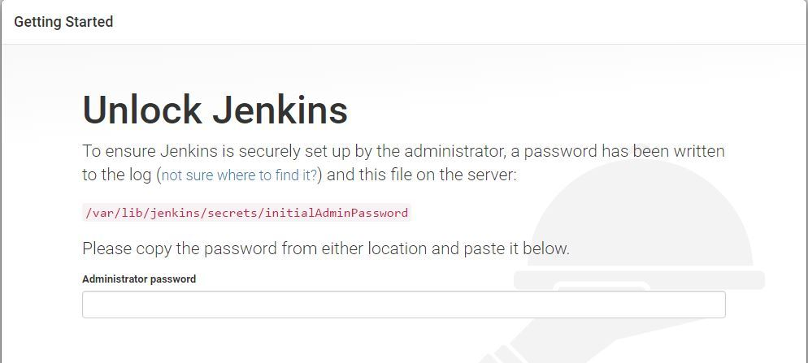
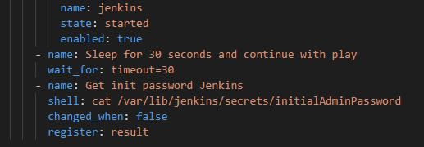
Login to Jenkins
The playbook that I have, by the end of the run, even displays PassPhrase for Jenkins.
If necessary, I also have a playbook for Jenkins-Node, which can be used to raise additional nodes without problems on which some work will be performed.

Slide 7
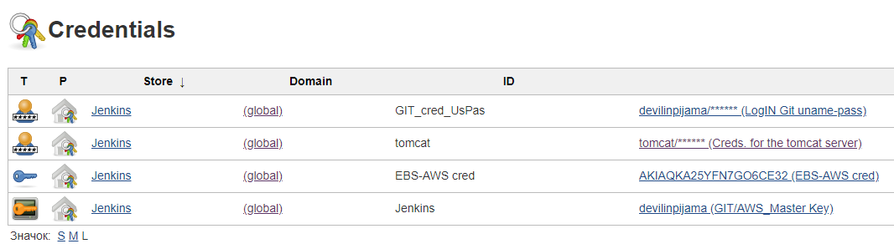
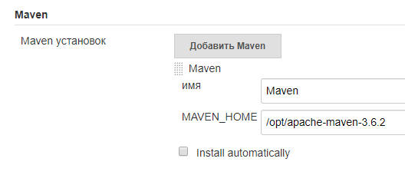
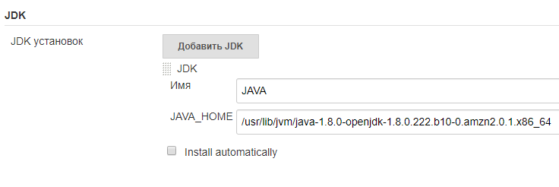
Setting Up Environment variables. And all credential.
The main advantage of deploying the environment through Ansible is that I do not need to go to the Jenkins Master machine, since all environment variables are set via Playbooks.
*Of course, it all went well, not the first time, but by the method of testing and mistakes, and some piece of patience.

Slide 8
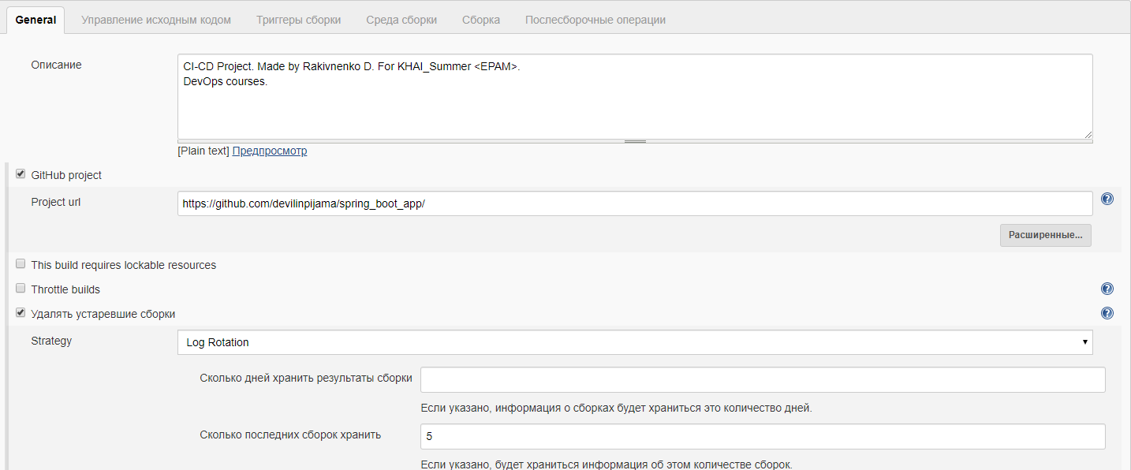
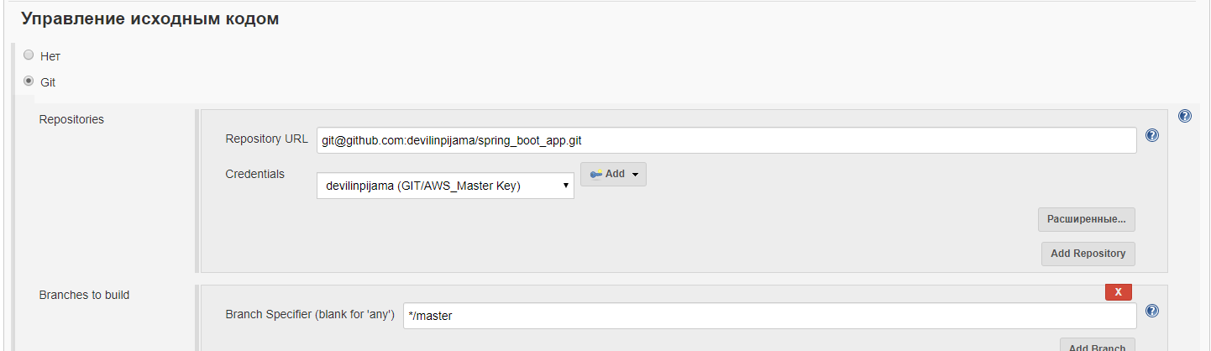
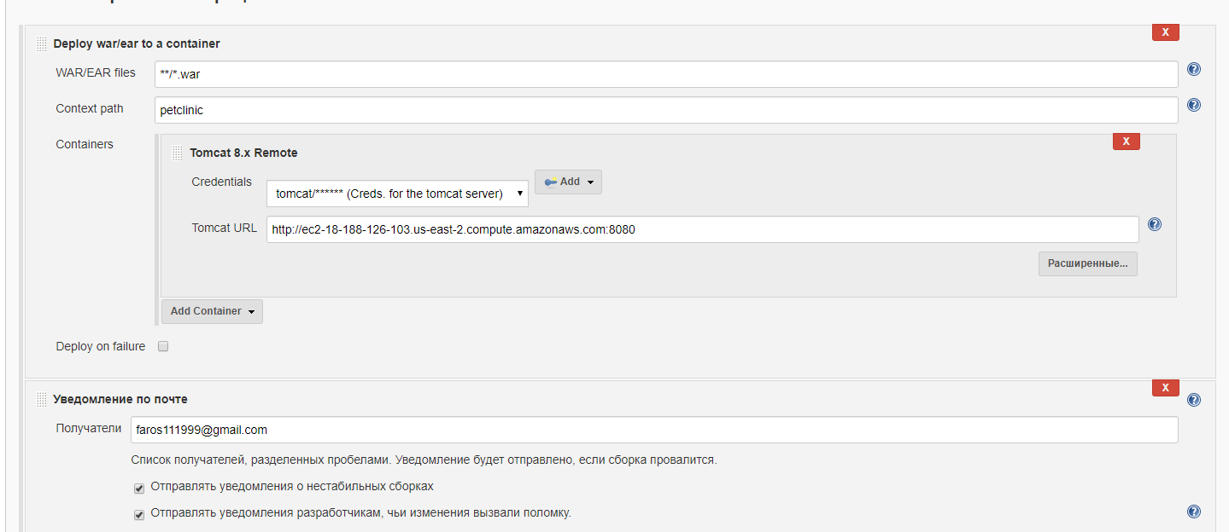
I create a FreeStyle project. Configure everything necessary for build and deployment.
Github project.
Webhook.
Deployment.

Slide 9
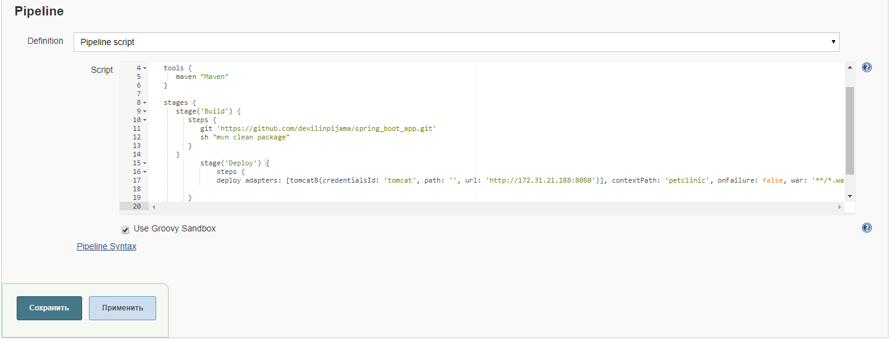
Or, as a Pipeline project.

Slide 10


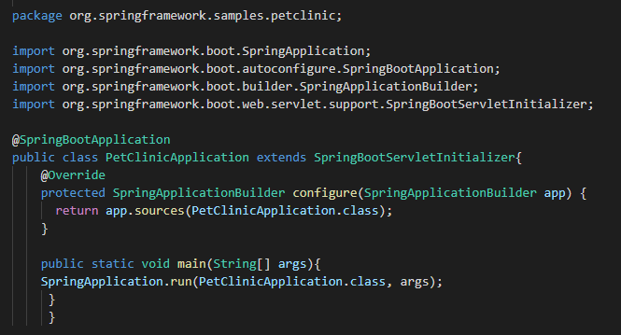
Application configuration:
It is also necessary to configure the code itself in order for the build to be made in .war format. One that can be deployed to tomcat without any problems. Since the source code is configured to build in .jar.
Pom.xml update
Petclinic.java updates

Slide 11
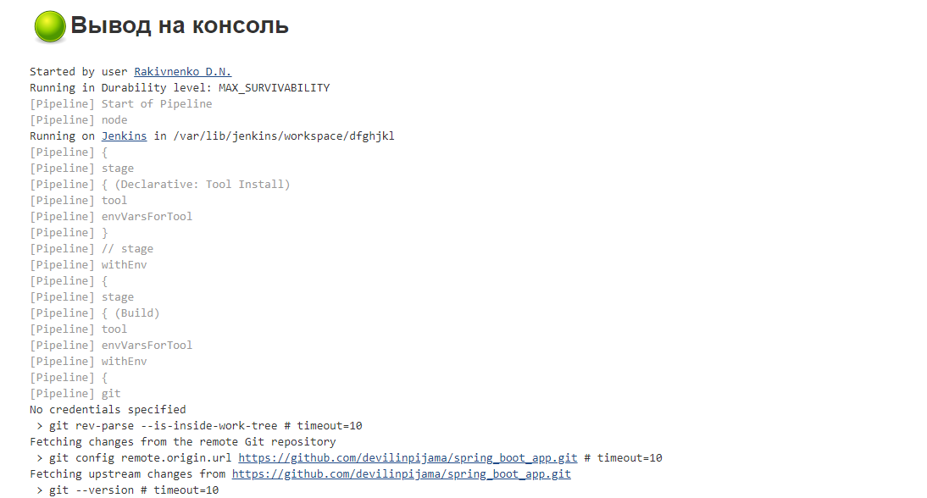
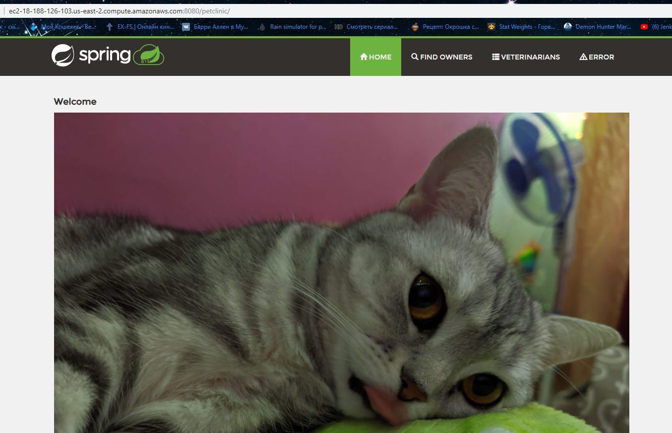
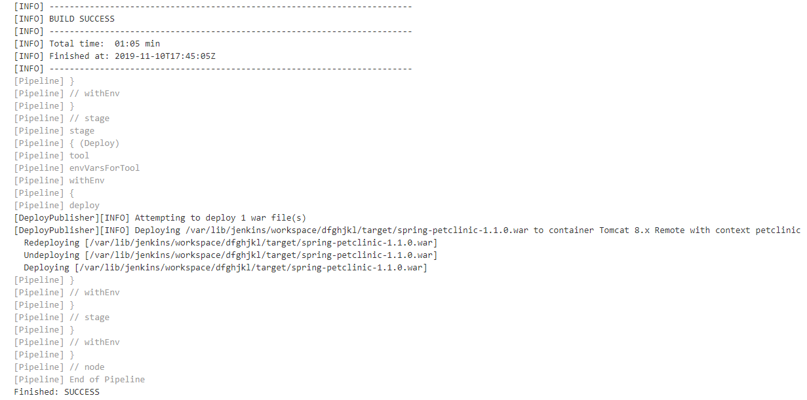
Build and Deploy.

Slide 12

Q&A session.

